Slide 1
Telematics
Galaxy noise
Jabneel cruz
Ceng317 hardware project

Slide 2
Proposal
The project will be able to detect car collision and save the recorded video into a file server to be used by the android application.
The goal of this project is to notify the car owner of an accident happening. The owner should be able to access the video of the recorded accident using their mobile application.

Slide 3
BUDGET / BILLS OF MATERIALS
Budget Lists | Type | Quanity | Price/Unit | Supplier | Product Code | Shipping Cost | Cost
Raspberry Pi 3 Starter Kit | Essential | 1 |  | Canakit |  |  | $99.99
PI Camera Module w/ Fish Eye Module | Essential | 1 |  | RobotShop | RB-Wav-46 |  | $38.45
Vibration Sensor | Essential | 2 | $9.74 | SeeedStudio | B01BQUW2KI | $4.69 | $19.50
Total of Essential Parts + Shipping |  |  |  |  |  |  | $157.94
Camera Module Case | Extra | 1 |  | SB Components | B00IJZJKK4 |  | $20.00
LCD Panel & Touch Pad | Extra | 1 |  | Elecrow | B013JECYF2 | $6.17 | $56.00
Total of Extra |  |  |  |  |  |  | $82.17
Total of Essential & Extra |  |  |  |  |  |  | $240.11
Current Spending |  |  |  |  |  |  | $184.11

Slide 4
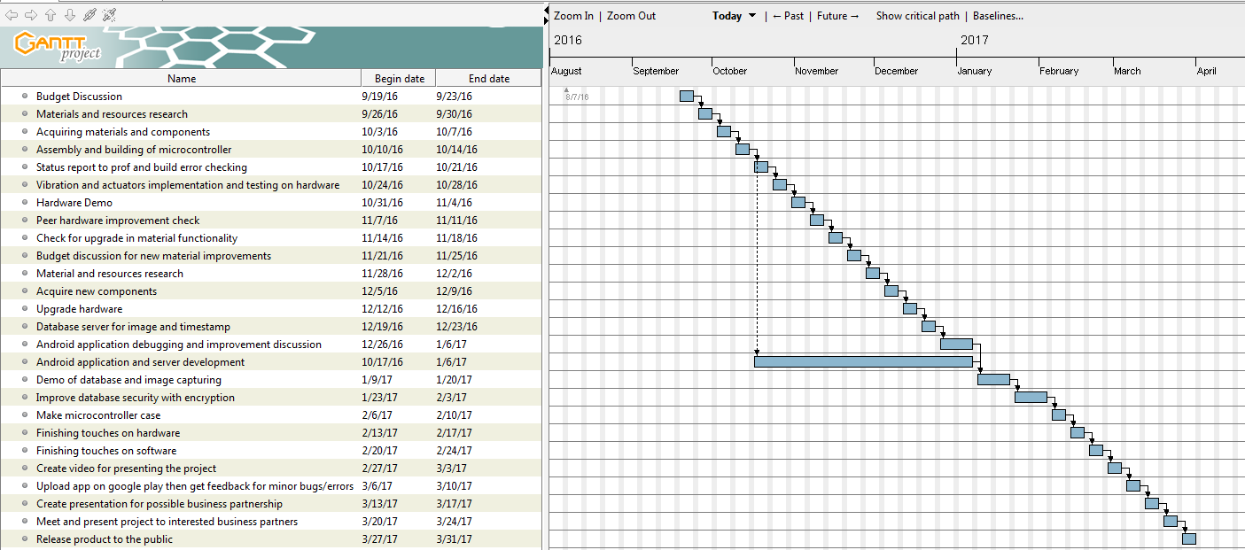
Schedule

Slide 5

BUILD VIDEO

Slide 6
Course Knowledge utilized
Internet programming, HTML Electronic Devices and Circuits
Unix Scripting
Technical C
Java
Database

